Slide 1
Interim-Project Presentation Grow Big Programme : B. Tech in CSE
Mentor :Prof. Kishor
Group No. : 4
Team Leader : Abhishek S
Department : Computer Science

Slide 2
Project Team
Sl no. | Registration no. | Students
1 | 17ETCS002001 | A Ragaa Vardhini
2 | 17ETCS002004 | Abhilash Ramu
3 | 17ETCS002007 | Abhishek S
4 | 17ETCS002028 | Anusha K S

Slide 3
Outline
Title and Aim
Introduction
Motivation
Objectives
Methods and Methodology ( or Block Diagram)
Status of the Work
Results(Optional)
Expected Outcomes
Cost Estimation
Gantt Chart
References

Slide 4
Title: Grow Big A Progressive Web Application for Scaling Small business
Aim:
To Develop A Full Stack Progressive Web Application to connecting all small businesses at one place

Slide 5
Introduction
With an introduction “To Develop A Full Stack Progressive Web Application for Scaling Small business”
Since it is a business scaling application all the store can register here in one place so users can select stores and order or shops from their known nearby stores.
To make items and groceries shopping a bit convenient and easier, so we are working on it which ensure timely delivery of groceries and higher money saving benefits and help small business.
Customers can get easily from where they are getting items and return as soon as possible.

Slide 6
Motivation
One of the significant issues in developing online Supermarket Grocery Supplies is to maintenance of the quality of the item and satisfy the customer requirements such as:
Delivering product on time
Increased changes of surfing things you want as there are multiple stores at a single location.
To provide transparency in purchasing items from where, quality and freshness of items, easy and fast returns.

Slide 7
Objectives
To conduct literature survey on scaling business systems
To analyze survey and collect requirements.
To Design & develop front-end user interface based on requirements
To Implement server side work develop Back-end to provide data to clients.
To develop PWA: Progressive Web Application for installation purpose.
To test developed application on local system.
To host live using appropriate service for usage purpose

Slide 8
Methods and Methodology /Block Diagram
1. To conduct literature survey on scaling business systems:
1.1: Conducted literature survey based on our business scaling application by referring some of existing application.
1.2: There are many grocery & Items ordering systems but not helpful for all small businesses and we want to help them to grow with us.
2. To analyze survey and collect requirements.
2.1: Based on information gathered and as per our application need requirements are collected.
2.2: User should be able to create account for their store and login.
2.3: System should show all the registered stores in home page.
2.4: Customer should be able to search stores and be able to order from their known sarounding particular store.

Slide 9
Methods and Methodology /Block Diagram
3. To Design & develop front-end user interface based on requirements:
3.1: As per requirements, need to develop front-end using appropriate technologies.
3.2: HTML,CSS for front-end portion and adding styles and javascript scripting language to make the site interactive for the user and to add useful functionalities.
3.3: Bootstrap to add inbuilt CSS components and styles. It also contains come basic components that we can directly use by copying code.
4. To Implement server side work develop Back-end to provide data to clients:
4.1: To store data, give back to client on user interface and carry necessary work and calculation on server side have to -

Slide 10
Methods and Methodology /Block Diagram
- choose appropriate back-end tools and frameworks.
4.2: Node.js helps to write javascript and run on server side.
4.3:Express.js is a Node js web application server framework, It has become the standard server framework for node.js. Express is the backend part.
4.4: MongoDB The standard NoSQL database for flexibility and ease of usage.
5. To develop PWA: Progressive Web Application for installation purpose.
5.1: Progressive Web Application which can be installed directly from browser and works same as native apps.

Slide 11
Methods and Methodology /Block Diagram
6. To test developed application on local system.
6.1: After development testing on local host by trying to access all the features and testing of database access.
6.2: Try to search stores and try to login and signup and checking the database that we are able to maintain proper user data.
7. To host live using appropriate service for usage purpose:
7.1: Purchase domain and hosting live website by choosing appropriate services.
7.2: Host the live website for use.

Slide 12
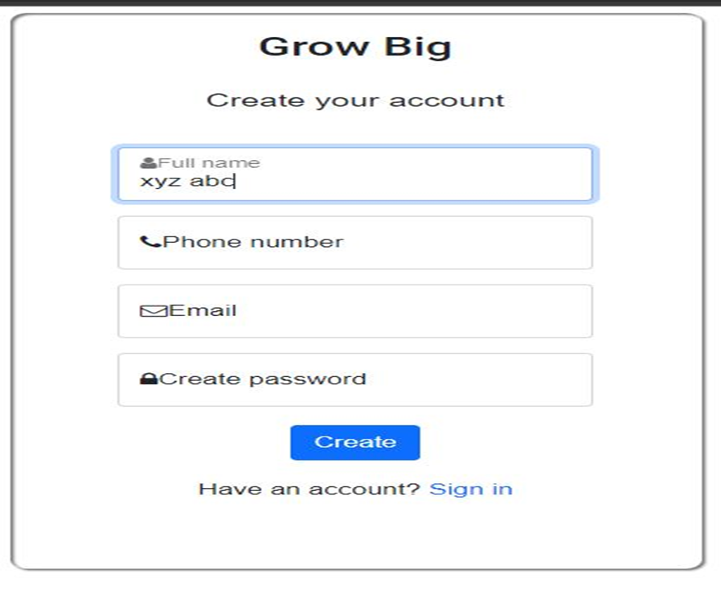
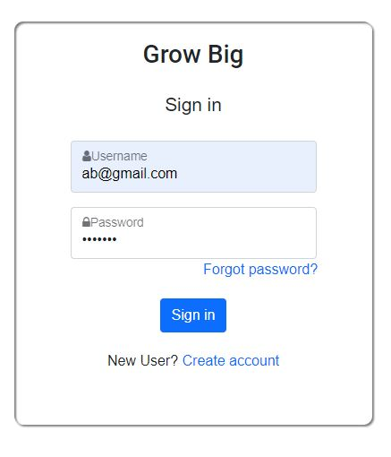
Results
Creating an account in “GROWBIG”. And Login page

Slide 13
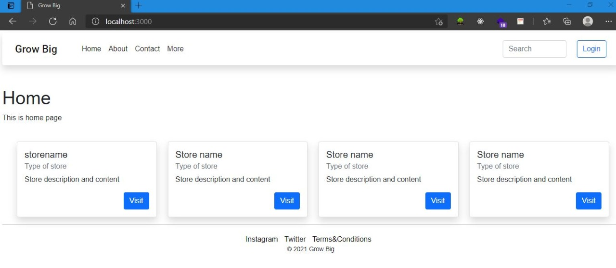
Results
Homepage displaying the stores added by admin for the visitor/customer to choose from available stores and “login” option along with “search” bar to surf shops

Slide 14
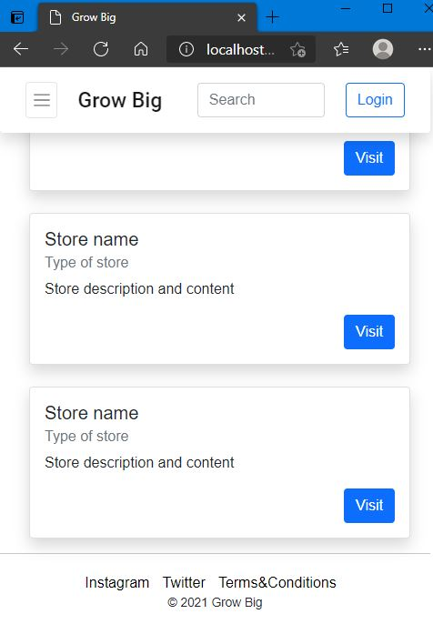
Results
This is how it looks in small screens for example in mobile phones. Responsive design.

Slide 15
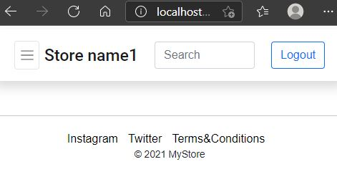
Results
When user loges in here they will launch, their home page

Slide 16
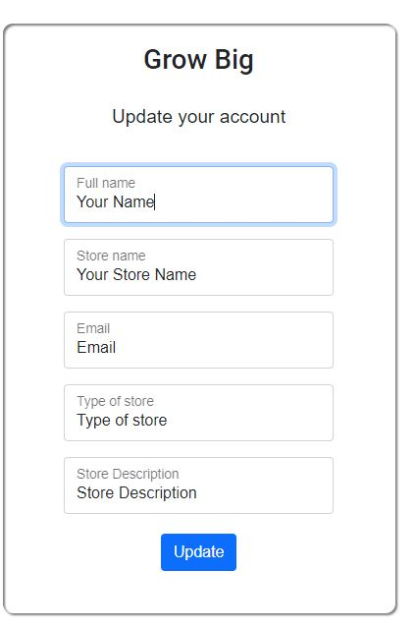
Results
A page to update one’s account in “GROWBIG”.

Slide 17
Status of the Work
Done with Literature survey.
Developed navigation bar using bootstrap
Data and information collection
Completion of front end
Added homepage with login and signup page
Created search filed and logout fields
Created a page to update details of the stores

Slide 18
Expected Outcomes
A well designed full stack web application(front-end & back-end)
A better Web application to connect all the small businesses and customers at one place.
PWA: Progressive Web Application which have installable feature and works as native apps.

Slide 19
TO-DO LIST
Adding all data to database “MONGODB”
OTP and password verification for online transaction
Adding more lists in the store and increasing it
Hosting the developed website

Slide 20
Cost Estimation
S.No. | Particulars/Components/Devices | Estimated Cost(Rs)
1 | Web Hosting | 200/mo=2400/yr
2 | Domain Purchase | 800/yr
 | Total: | 3200/yr
Man hours:
Man hours per week (students): 18 *4 students =72
Man hours per week (faculty): 3

Slide 21
Gantt Chart
Week | 1 | 2 | 3 | 4 | 5 | 6 | 7 | 8 | 9 | 10 | 11 | 12
Major activities
Literature survey
Web design
Frontend development
Backend development
Report submission and documentation

Slide 22
Gantt Chart
MEMBERS | RAAGAVARDINI |  | ABHILASH |  | ABHISHEK |  | ANUSHA
Major activities
Literature survey
Web design
Frontend development
Backend development
Report submission and documentation

Slide 23
References
Binayak Panda , Pradeepta Kumar Panigrahi,2012 , April .A Model for Small Scale Website Development Gandhi Institute of Engineering & Technology ,Gunupur ,Orissa ,India. IJCST Vol.3,Issue 2,April –June 2012
Chai Lee Goi,“The impact of website development on organisation performance: Malaysia’s perspective”, African Journal of Business Management Vol. 6(7), 22, pp. 2435-2448, 2012.
San Murugesan, Yogesh Deshpande, Steve Hansen and Athula Ginige,“Web Engineering: A New Discipline for Development of Web-based Systems”,WebISM (Web-based Information Systems and Methodologies) Research Group, Campbelltown, Australia.

Slide 24
Thank You

